Slide 1

Proposed locations for Installation of
PIT Tag Antennas at John Day Dam Adult Ladders
PTAGIS Field Office
Kennewick, Washington
June 2015

Slide 2
South Ladder

Slide 3
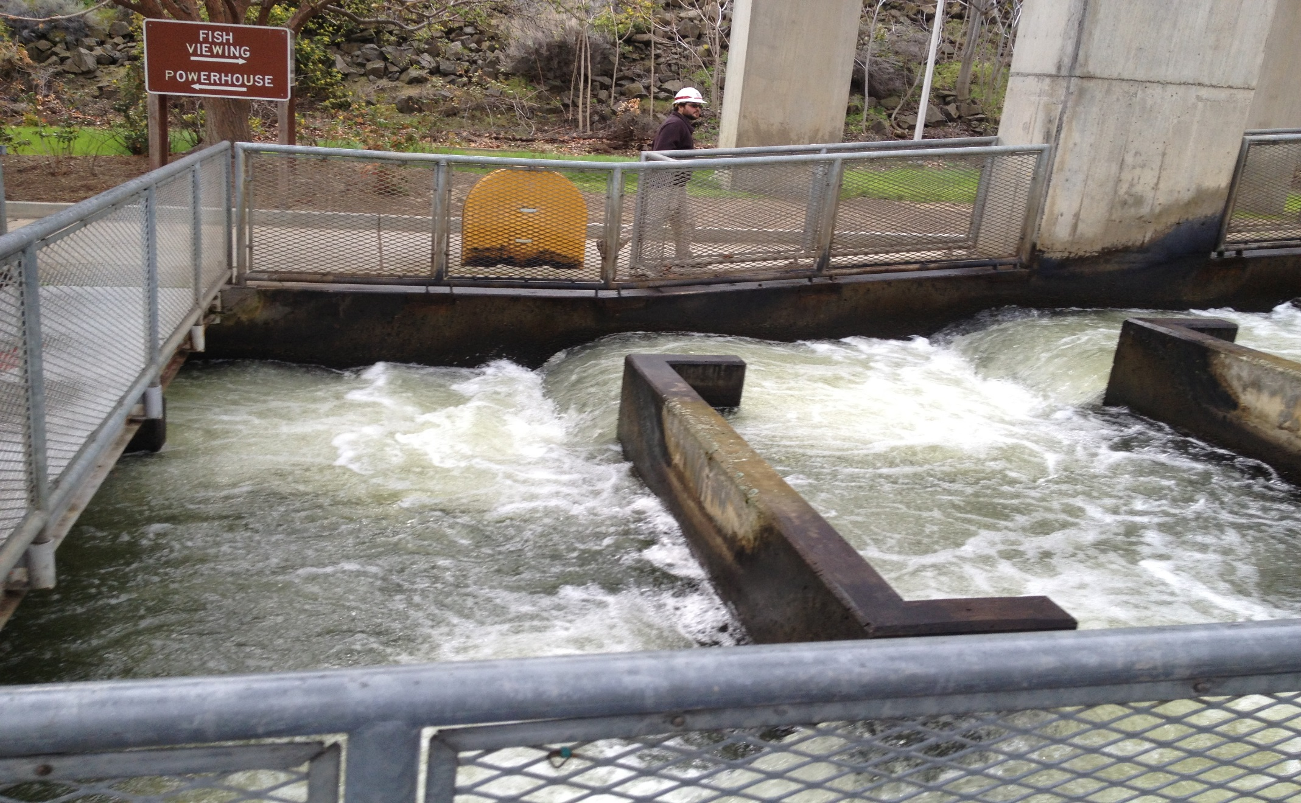
South Ladder

Slide 4
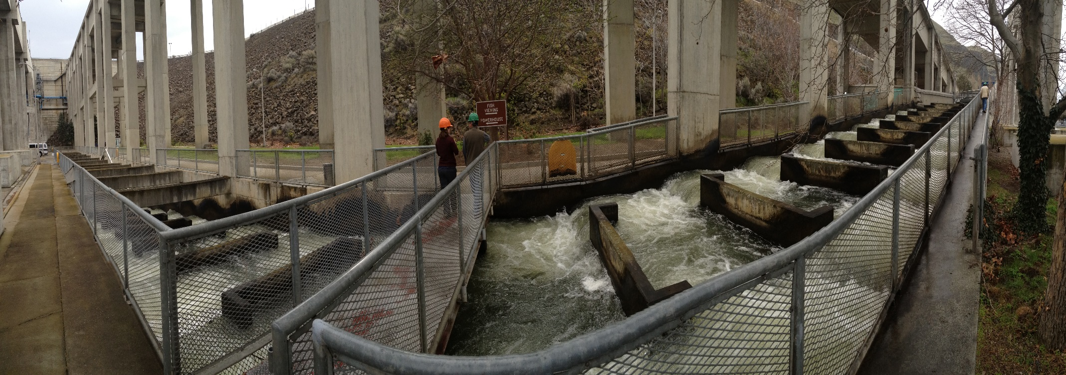
South Ladder

Slide 5
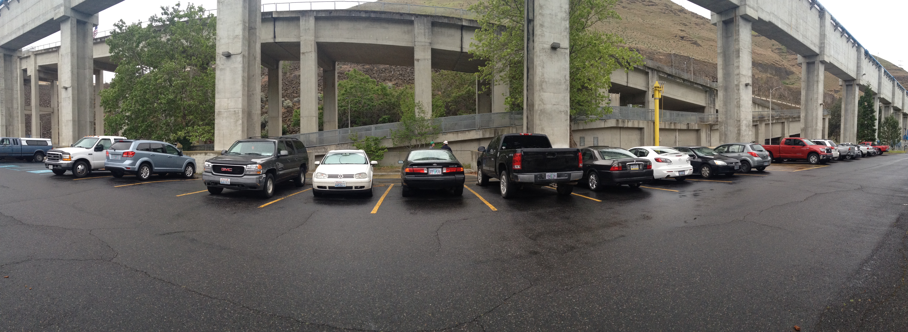
South Ladder

Slide 6
North Ladder Preferred

Slide 7
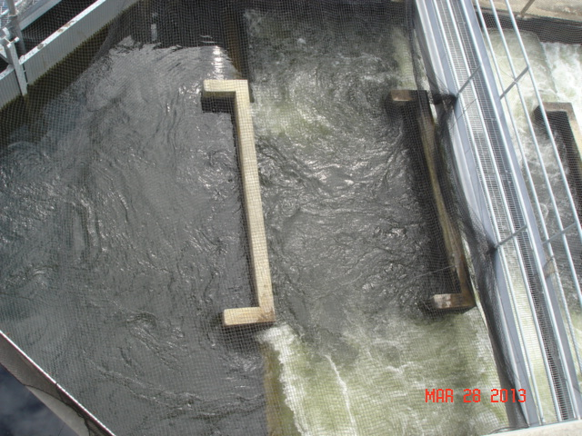
North Ladder
Notes:
.

Slide 8
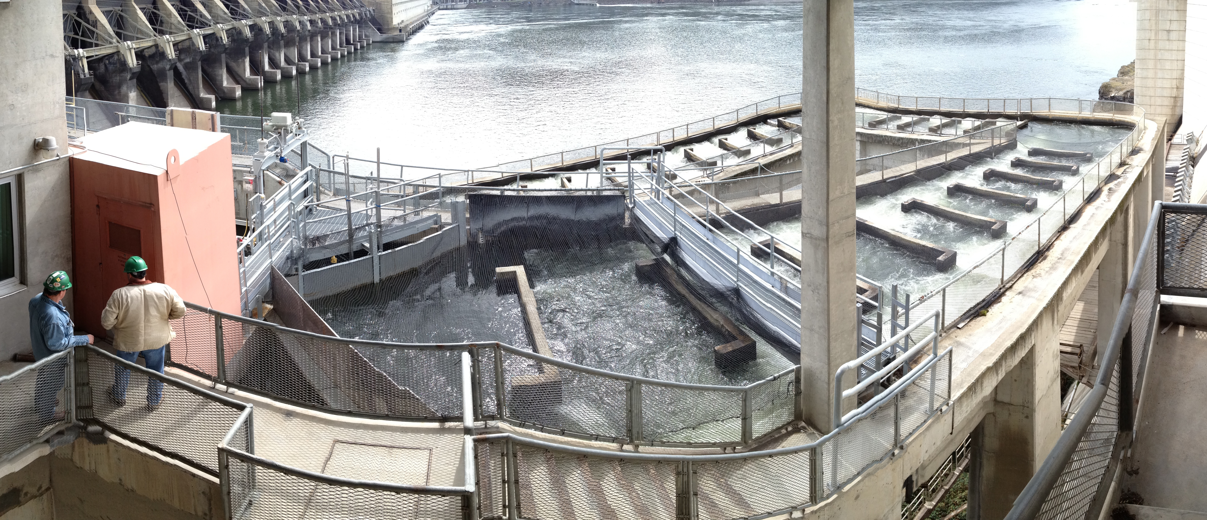
North Ladder
Notes:
.

Slide 9
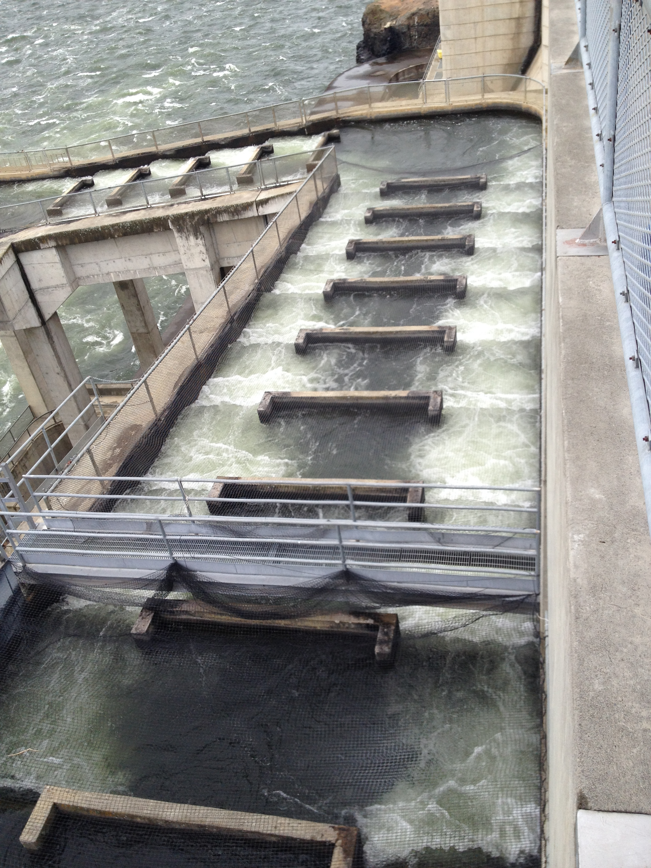
North Ladder

Slide 10
North Ladder: Option 2

Slide 11
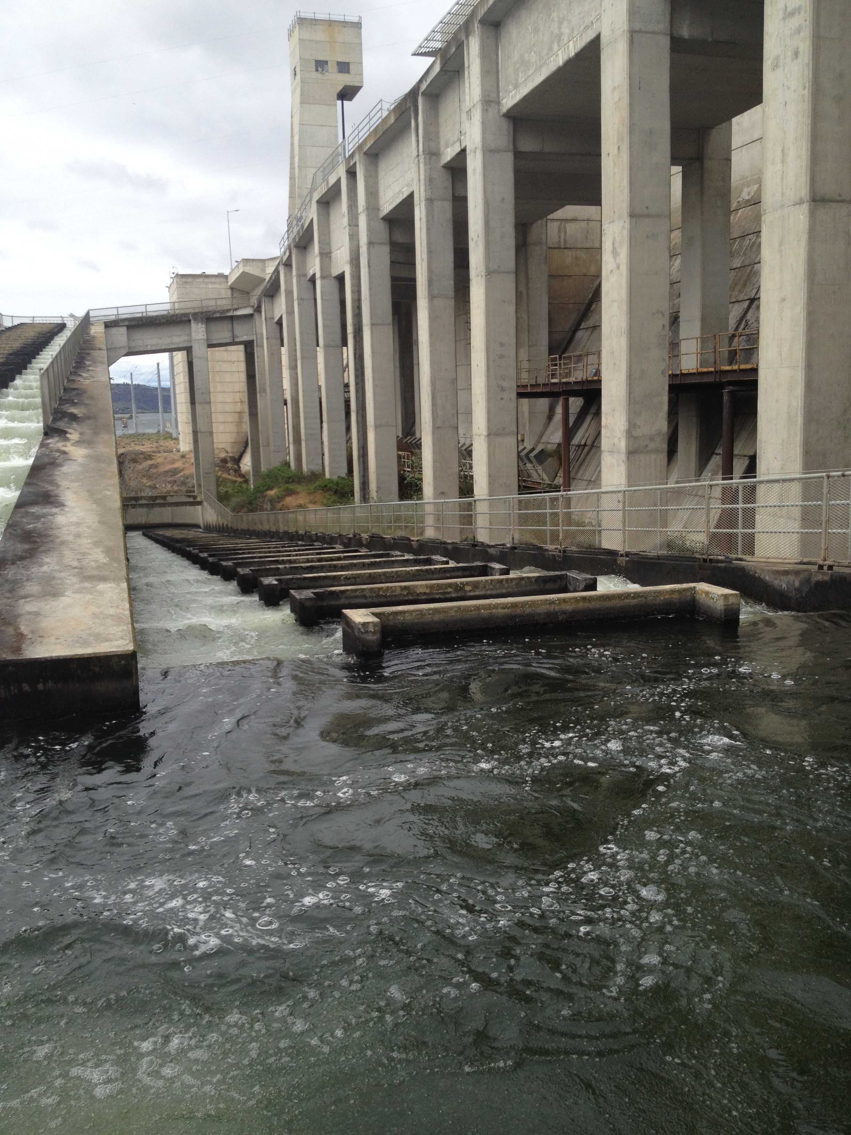
North Ladder: Option 2

Slide 12
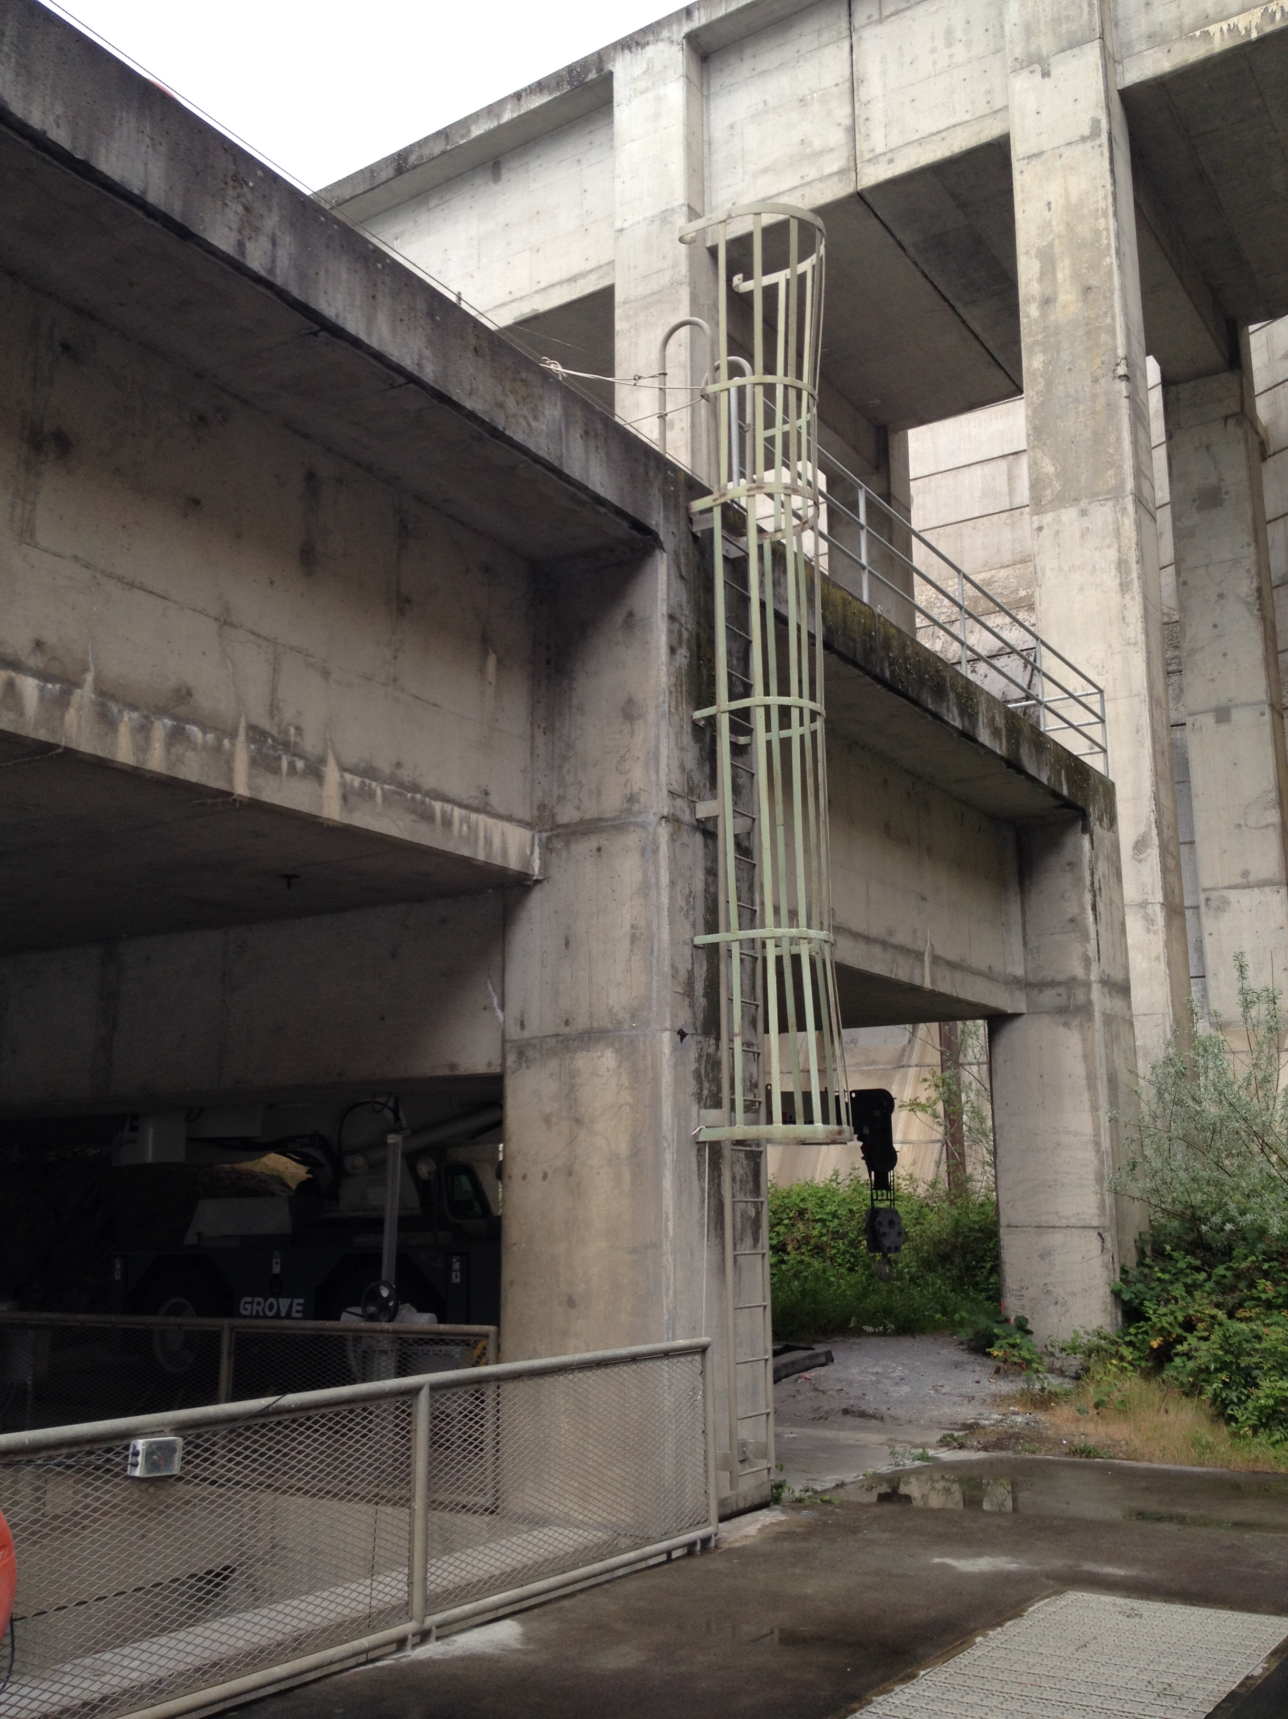
North Ladder: Option 2

